Slide 1
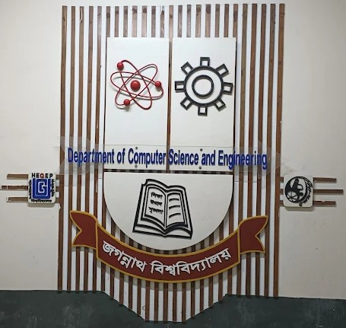

Advanced Cloud Computing
Enhancing Lung Cancer Diagnosis with Data Fusion and Mobile Edge Computing using DenseNet and CNN
Presented By:
Presented To:
Student's Name | Student's ID
Md. Romzan Alom | M250205010
Md Ashiqur Rahman | M250205011
Saddam Hossen | M250205027
Abu Salah Musha Lemon | M250205039
Md. Hasan Mia | M250205025
Dr. Md. Abu Layek Professor Department of CSE
Group Name: Cloud Station
Group No: 08
Department of Computer Science and Engineering (CSE)
Jagannath University

Slide 2
Agenda
Introduction
Related Work
Proposed Methodology
Result Analysis
Conclusion
Related to Course
References
Question and Answer
Enhancing Lung Cancer Diagnosis with Data Fusion and Mobile Edge Computing using DenseNet and CNN

Slide 3
Introduction (1/2)
Paper Authors: Chengping Zhang, Muhammad Aamir, Yurong Guan, Muna Al‑Razgan, Emad Mahrous Awwad, Rizwan Ullah, Uzair Aslam Bhatti and Yazeed Yasin Ghadi
Journal Name: Journal of Cloud Computing: Advances, Systems and Applications
Index: Science Citation Index Expanded (SCIE)
Quartile: Q1
Impact Factor: 4.3
Summary of this paper: Zhang et al. [1] proposed a DenseNet-CNN system with data fusion and mobile edge computing for lung cancer diagnosis from CT scans. The method enhances feature extraction and real-time processing, achieving 99% accuracy on classification tasks. Despite strong performance, its limitations include dependency on large annotated datasets, limited interpretability, and reduced generalizability across diverse populations and imaging devices.
Enhancing Lung Cancer Diagnosis with Data Fusion and Mobile Edge Computing using DenseNet and CNN

Slide 4
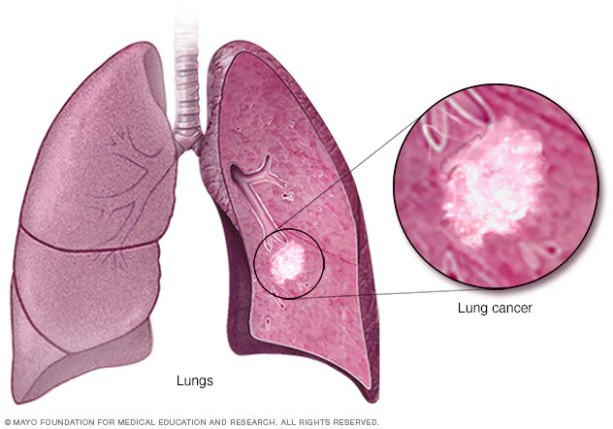
Introduction (2/2)
Lung cancer remains a leading global health issue causing millions of deaths annually.
Early detection significantly improves survival, but most cases are diagnosed at advanced stages.
Low-dose CT imaging enables accurate early detection and reduces lung cancer mortality rates.
Most lung cancer cases are preventable, primarily linked to smoking and environmental factors.
Deep learning, especially CNNs, enhances CT image analysis and early cancer diagnosis accuracy.
Enhancing Lung Cancer Diagnosis with Data Fusion and Mobile Edge Computing using DenseNet and CNN

Slide 5
Related Work
Innovative deep learning strategies
Combining knowledge‑based systems and machine learning
Exploring DenseNet and multiple view‑based models
Region‑based CNNs and deep reinforcement learning
3D CNNs and ANN‑based models for enhanced sensitivity
MLP and automated approaches for comprehensive analysis
Transfer learning and specialized CNN models
Diverse techniques for NSCLC and histopathology analysis
Hybrid models and data integration for early detection
Emerging trends and future directions
Enhancing Lung Cancer Diagnosis with Data Fusion and Mobile Edge Computing using DenseNet and CNN

Slide 6
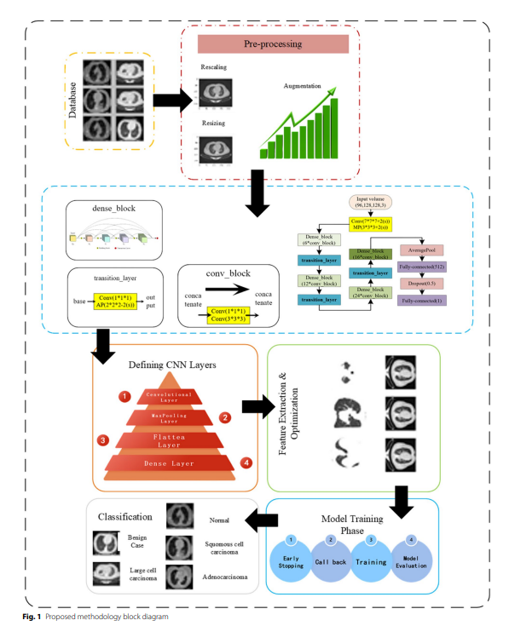
Proposed Methodology
Dataset
Preprocessing
Densenet
CNN
Feature Extraction
Model Training
Classification
Enhancing Lung Cancer Diagnosis with Data Fusion and Mobile Edge Computing using DenseNet and CNN

Slide 7
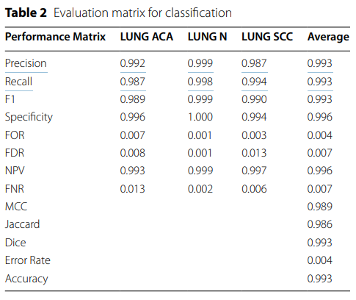
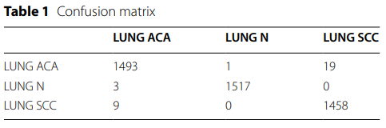
Result Analysis
Enhancing Lung Cancer Diagnosis with Data Fusion and Mobile Edge Computing using DenseNet and CNN

Slide 8
Conclusion (1/3)
Summary:
CNNs excel in lung cancer CT image analysis
DenseNet121 improves feature extraction and accuracy
Strong gradient flow enhances deep model training
Reduces overfitting with efficient parameter usage
High accuracy and faster performance in detection
Enhancing Lung Cancer Diagnosis with Data Fusion and Mobile Edge Computing using DenseNet and CNN

Slide 9
Conclusion (2/3)
Limitations:
Limited availability of labeled medical datasets
Image quality variations affect performance
Requires high computational resources for training
Generalization across scanners and populations is difficult
Limited interpretability for clinical decision-making
Enhancing Lung Cancer Diagnosis with Data Fusion and Mobile Edge Computing using DenseNet and CNN

Slide 10
Conclusion (3/3)
Future Work:
Expand datasets with diverse CT images
Develop hybrid and ensemble deep models
Integrate explainable AI for clinical trust
Optimize models for real-time hospital deployment
Validate performance through clinical collaborations
Enhancing Lung Cancer Diagnosis with Data Fusion and Mobile Edge Computing using DenseNet and CNN

Slide 11
Related to Course
Mobile Edge & Cloud Computing Integration – Used MEC with cloud collaboration for real-time, low-latency medical data processing.
AI-as-a-Service (AIaaS) Deployment – Implemented DenseNet-CNN via scalable cloud GPU infrastructure for intelligent diagnostics.
Scalability, Reliability, and Resource Optimization – Optimizes edge-cloud resources for efficient, high-performance AI workflows.
Security, Privacy, and Compliance – Protected sensitive medical data using edge privacy controls and secure cloud frameworks.
Cloud-Based System Architecture – Adopted layered edge-cloud-AI structure enabling distributed intelligent healthcare services.
Enhancing Lung Cancer Diagnosis with Data Fusion and Mobile Edge Computing using DenseNet and CNN

Slide 12
References
C. Zhang, M. Aamir, Y. Guan, M. Al-Razgan, E. M. Awwad, R. Ullah, U. A. Bhatti, and Y. Y. Ghadi, "Enhancing lung cancer diagnosis with data fusion and mobile edge computing using DenseNet and CNN," Journal of Cloud Computing: Advances, Systems and Applications, vol. 13, no. 91, 2024. doi: 10.1186/s13677-024-00597-w.
Enhancing Lung Cancer Diagnosis with Data Fusion and Mobile Edge Computing using DenseNet and CNN

Slide 13

Have Any Question ?
Advanced Cloud Computing
THANK YOU !!
Enhancing Lung Cancer Diagnosis with Data Fusion and Mobile Edge Computing using DenseNet and CNN

